Slide 1
Customer sentiment analysis
Mojtaba Farmanbar

Slide 2




Rebtel:
Swedish calling company since 2006
1) Services include international calling,
2) Messaging,
3) Mobile money delivered in apps for Android, iPhone and Windows
In a very competitive market of telecom industry,
it is very challenging to increase market share or
even keep the current customers.
Gaining insight in customers' sentiments towards Rebtel,
and possible drivers for these sentiments.

Slide 3

Outline:
Analysis steps
Data collection
Data exploration
Modeling
Improving models
Future work

Slide 4
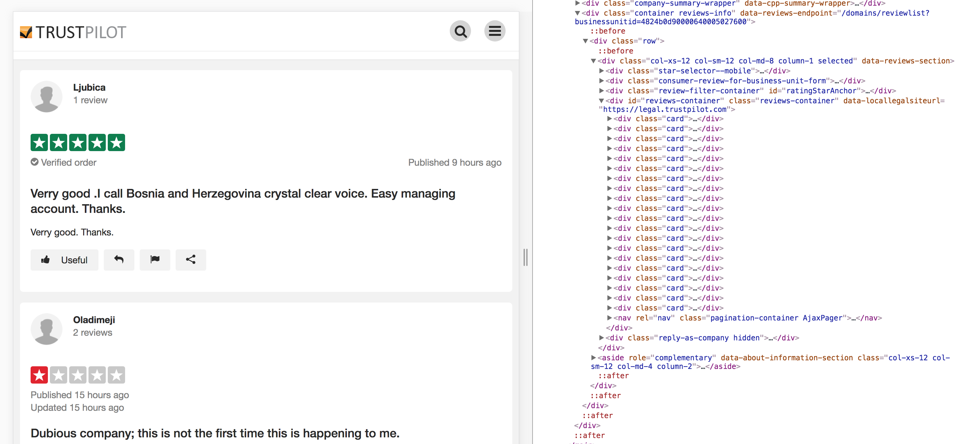




Web Scraping:
Using BeatifulSoup to scrape data from trustpilot:
What are interesting features to have?
Reviews-container
All reviews in one page
Pages-container

Slide 5
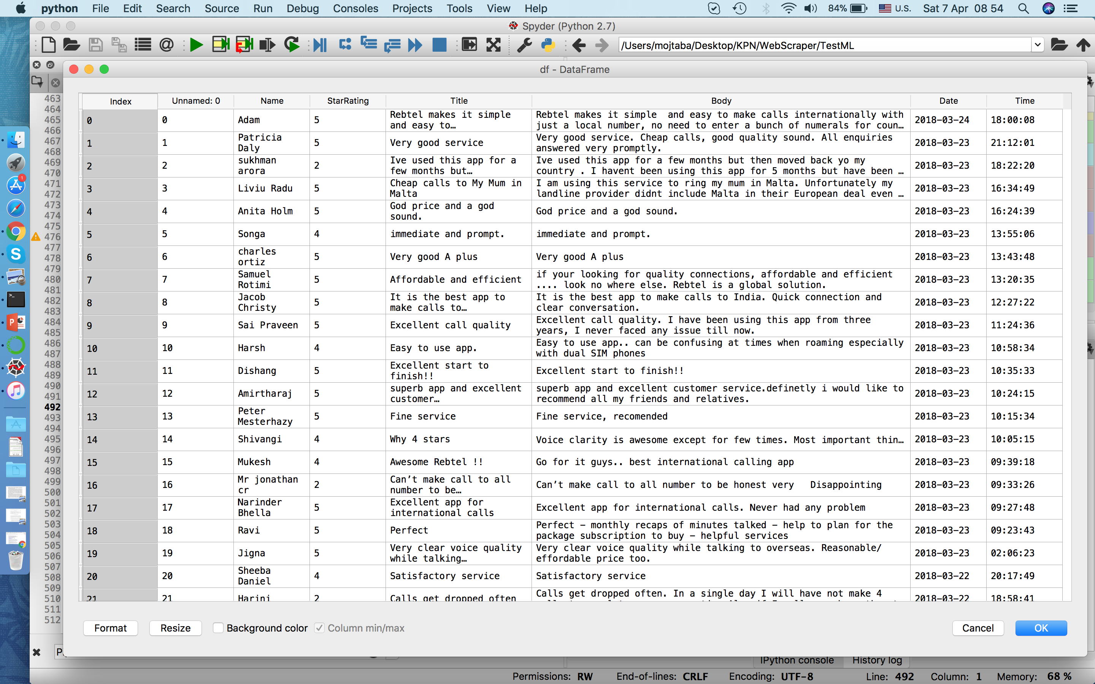
Dataset:
The dataset contains Name, Rating, Title, Body, Date, and time
Target
Features included in model
Data for viz
.
.
.
.
.
.
.
.
.
.

Slide 6

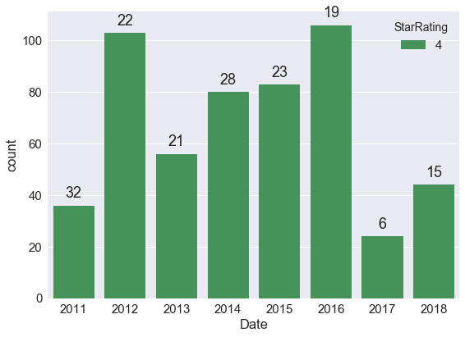
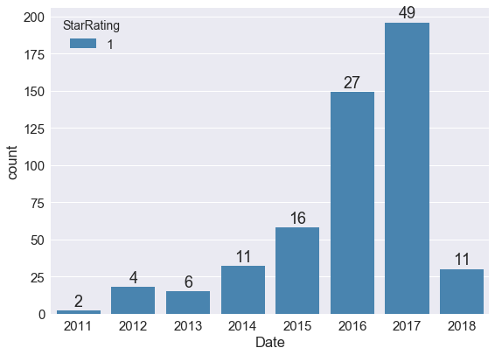
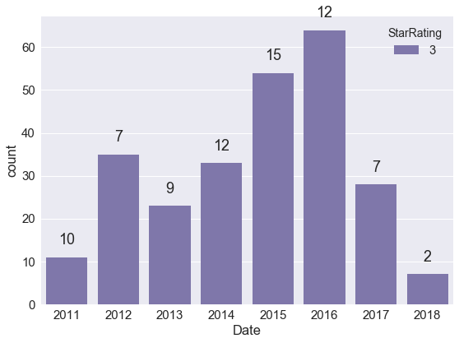
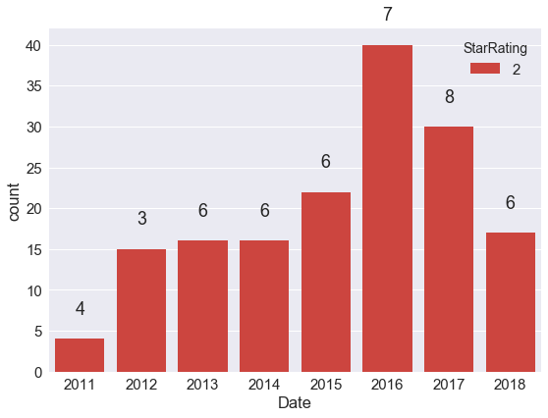
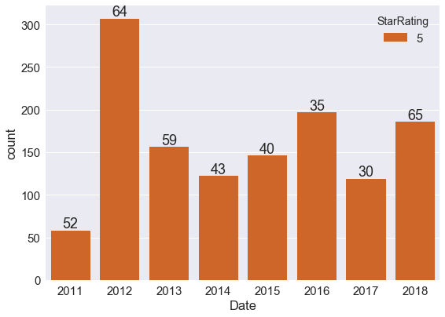
Infographic:
Counting number of reviews from 2011 to 2018:
Very bad and bad review
Neutral reviews
Good and very good reviews
Increase
This number indicates the percentage
of reviews at given year.

Slide 7
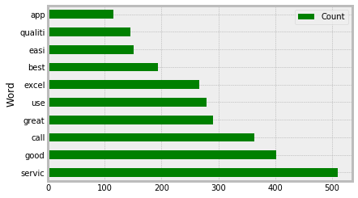

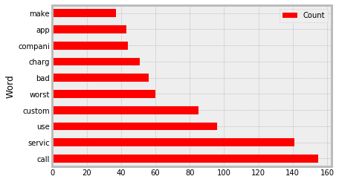

Stop words:
Top 10 most frequent words:
Cleaning data (body and title) from stop words
Removing punctuation marks.
Removing stop words.
Extracting the stem of words.
Result of top 10 words analysis
Quality
Easy
Best
great
Common words:
App
Service
Call
use
bad
Worst
charge

Slide 8



Predictive model:
We use the predicting model:
Classifying customers as their sentiments
How to solve
Their problem
How to make
them happy
Needs to be
improved
Bad at it
Very good at it

Slide 9
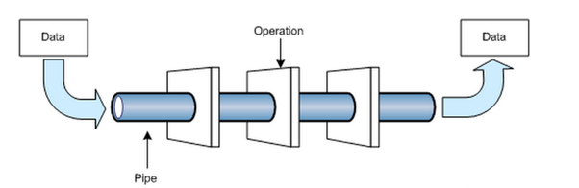
Model:
Pipeline:
70% dataset (training set)
Trained model
With set of parameters
TfidfTransformer
Applying our model
to test set(30% test set)
CountVectorizer
SGDClassifier
Log
hinge
modified huber
Cleaned data from stop words
Extracting confusion matrix
and accuracy score

Slide 10
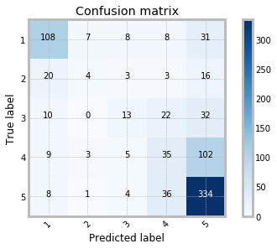
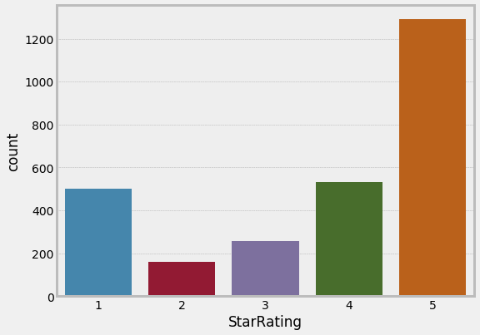

Result:
Applying our model to the dataset
The distribution of rating
The dataset is imbalanced which
causes to bad training of model.
The accuracy score is 60%

Slide 11

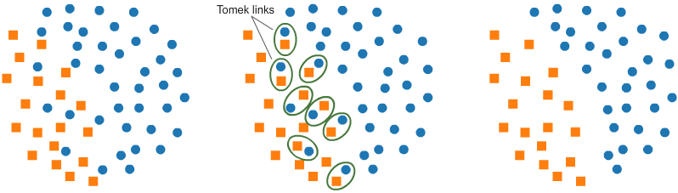
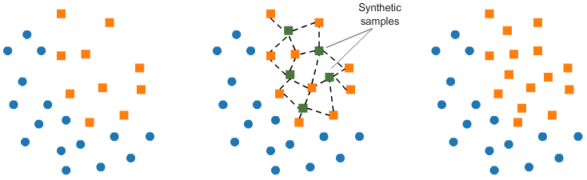
Resampling:
Different approaches to do resampling:
Under-sampling: Tomek links
Over-sampling with SMOTE

Slide 12

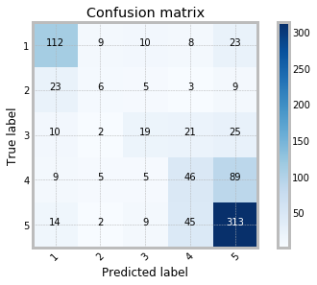
Result:
Up-sampling with SMOTE:
Up-sampling with random oversampling:
The accuracy score: 61%
The accuracy score: 60%

Slide 13
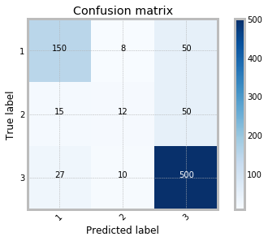
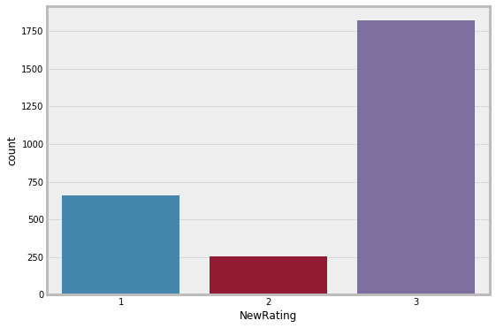
Approach 1:
Up-down sampling with SMOTETomek:
Combining bad and very bad reviews as Bad and good
and very good as Good.
Good
Bad
Neutral
The accuracy score: 81%

Slide 14
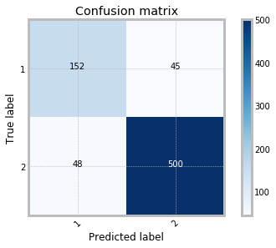
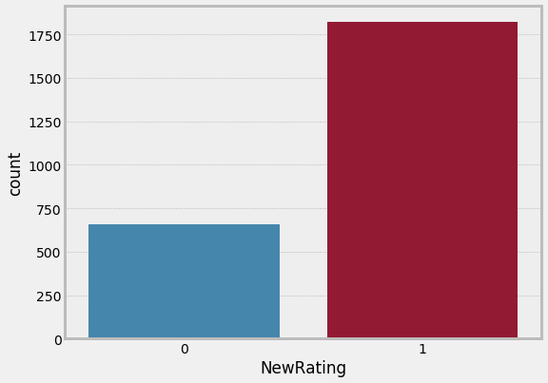
Approach 2:
Up-down sampling with SMOTETomek:
In addition to approach 1, removing neutral reviews.
Good
Bad
The accuracy score: 88%
The g-mean score: 84%

Slide 15

Future work:
Penalizing algorithms.
Tree-based algorithm.
Context analysis with keyword selection.
Adding date and time into dataset.

